Slide 1

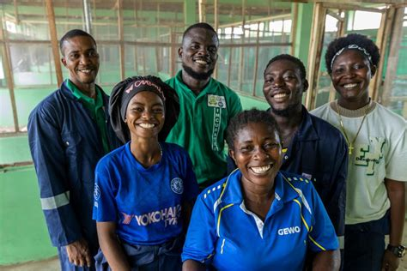

Development Finance for Youth in a Changing Landscape –
Global Development Finance Trends
Savis Sadeghian
Senior Technical Specialist – Multilateral Climate and Environmental Funds
Environment, Climate, Gender and Social inclusion (ECG)
Office of Technical Delivery (OTD)

Slide 2
Global Development Finance: A Time of Transition
Developing countries need over USD 4 trillion annually to meet SDG and climate goals
ODA and concessional aid are under pressure; shift toward blended and private finance
Emerging instruments: green bonds, carbon credits, climate funds, results-based finance
Risk: youth-led and small projects remain excluded unless design is inclusive

Slide 3
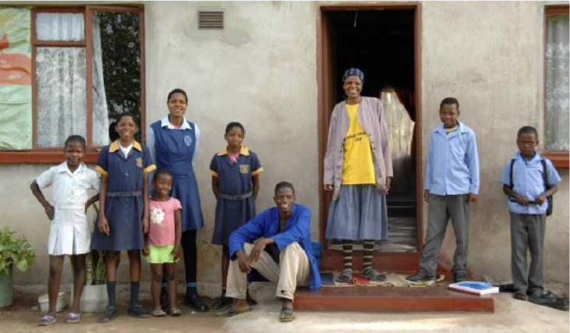
Youth Employment: Urgency and Opportunity
Youth unemployment is triple adult rates; many in informal, low-productivity work.
Youth drive innovation in climate, energy, agriculture, digital tools.
Only ~20% of NDCs address youth access to finance, revealing a financing gap.
Youth inclusion is rising in policy, but not yet in financial access.

Slide 4

Emerging Financing Mechanisms
Green Bonds & Sustainability Loans: finance clean energy, jobs, infrastructure.
Carbon Markets: channel benefits to youth-led reforestation, agriculture, clean cooking.
Results-Based & Impact Bonds: link returns to verified youth employment outcomes.
Blended & De-risking Vehicles: lower entry barriers and improve bankability for youth.

Slide 5
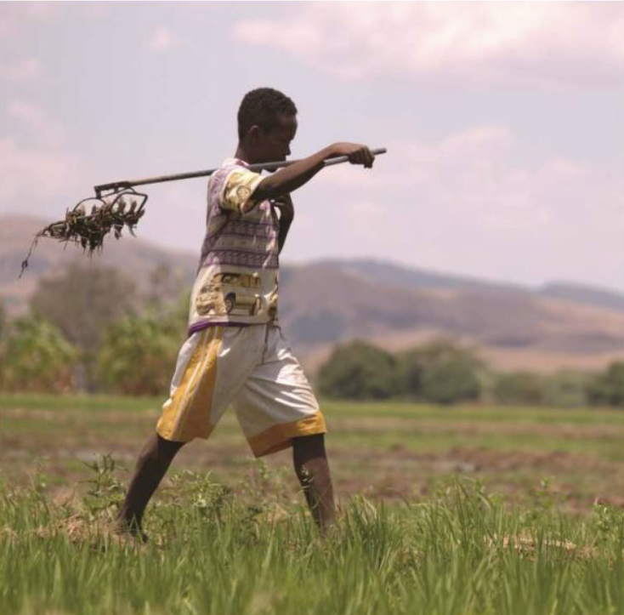
Catalytic Role of Climate Funds
i.e GCF and GEF expanding inclusive access via local entities and small-grant windows.
Examples: E-Mobility Program (GCF Africa), GEF Challenge Program for youth start-ups
New NDCs embed GESI safeguards and youth roles — but finance pathways remain vague
Need to link climate fund access directly to youth inclusion mechanisms.

Slide 6
The Way Forward: Making Finance Youth-Inclusive
Create youth windows, quotas, and advisory roles in climate and blended funds.
Use blended capital and guarantees to de-risk youth ventures.
Simplify access and pair finance with mentorship and technical support.
Measure quality and inclusivity of jobs; use youth- and gender-disaggregated data.
Align NDCs and finance to institutionalize youth participation and accountability.

