Slide 1
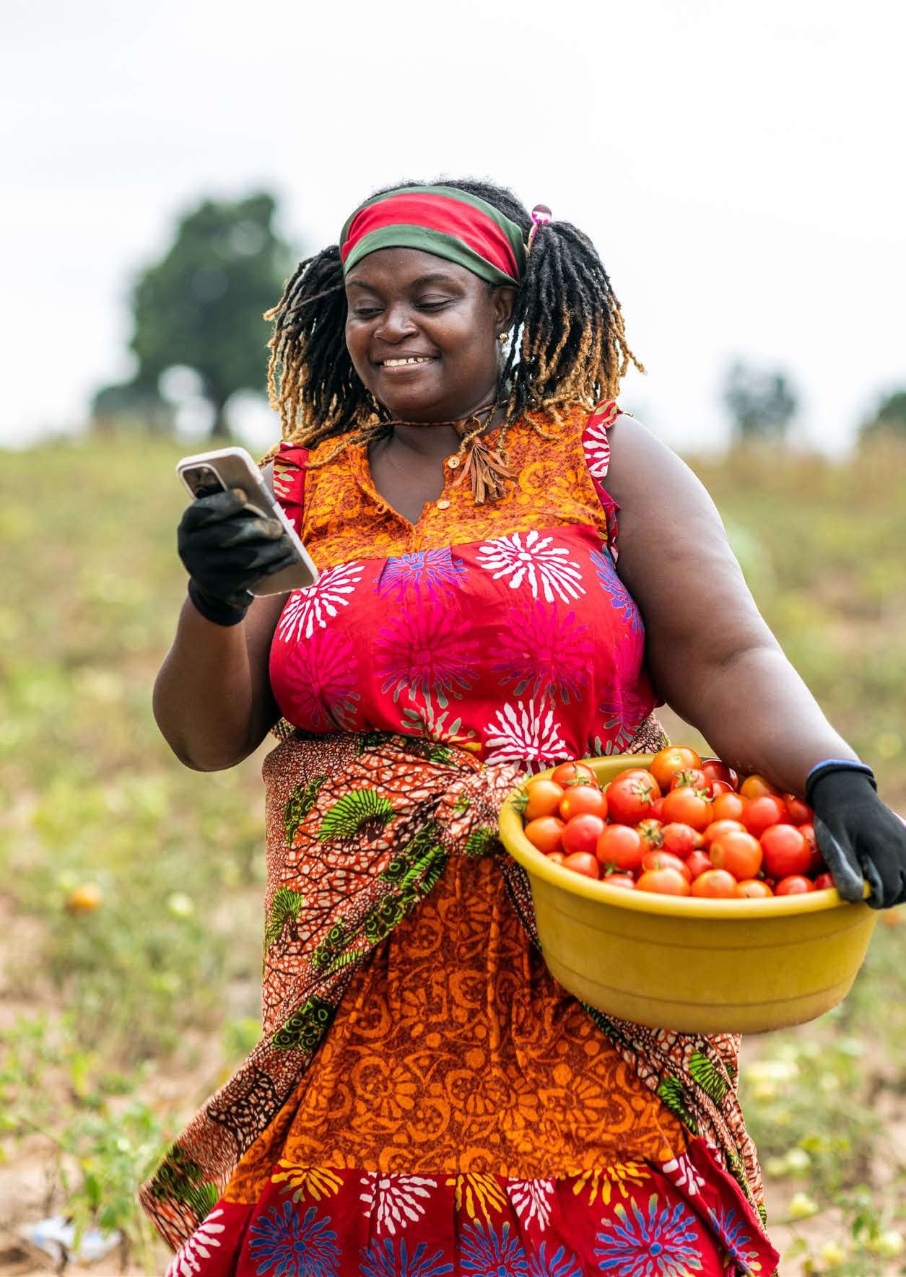

Harnessing Artificial Intelligence in GAIN's Programmes
A strategy overview
Ty Beal, PhD
Senior Technical Specialist, GAIN
Healthier Diets. For all.

Slide 2



THE OPPORTUNITY
Why AI, and why now?
The challenge
The shift
The moment
Billions remain malnourished and food systems are transforming too slowly. Our programmes hit the same limits again and again: weak or missing data, hard-to-reach populations, complex supply chains, and slow, costly compliance checks.
78%
The foundations we lay now will decide whether AI narrows nutrition gaps or widens them, so we move with clear eyes on both AI's potential and its risks.
of organisations now use AI in at least one business function, up from 55% a year earlier. Like mobile money before it, AI is a catalytic technology the sector can harness.
GAIN's Strategy for Harnessing AI in Programmes

Slide 3




OUR AMBITION
AI as a strategic enabler, not a black box
AI is a strategic helping hand that enhances our expertise, informing human judgment, not replacing it. We intend to use AI to design more impactful programmes, deliver them more efficiently, and scale them faster, always in service of our mission: healthy diets for all, especially the most vulnerable.
GUIDED BY THREE PRINCIPLES
Problem-driven
Human-centred
Equitable
Led by programmatic needs, not by technology for its own sake.
Built with and around the people who use and benefit from the tools.
Designed to narrow nutrition gaps, with access and inclusion built in.
Accelerate GAIN's own impact: designing, delivering, and scaling programmes better.
Help shape the wider sector: through thought leadership and replicable models.
GAIN's Strategy for Harnessing AI in Programmes

Slide 4







THE FRAMEWORK
How AI adds value across our programmes
ACROSS THE PROGRAMME LIFECYCLE (GAIN's 2022–2027 strategy)
DESIGN
DELIVERY
SCALE
Understand what's needed (e.g. map deficiency hotspots).
Do it well (e.g. speed up fortification QA; personalise advice).
Reach all who benefit (e.g. find areas to expand).
THROUGH THREE MODES OF AI VALUE
Innovate
Reinvent
Optimise
new idea, new model
same goal, new design
same design, smarter run
Do what wasn't possible before: uncover patterns and generate wholly new approaches.
Fundamentally redesign existing programmes for greater effectiveness and relevance.
Automate, predict, and personalise—learn faster what works and what doesn't.
These dimensions overlap: programmes may blend innovation, reinvention, and optimisation at once.
GAIN's Strategy for Harnessing AI in Programmes

Slide 5


OUR ROLE
Disciplined and problem-first
We invest only where we have a comparative advantage, an unmet need, and high potential for impact.
What we will do
What we won’t do
Cross-cutting: chatbots that make advice & training accessible on platforms people already use (e.g. WhatsApp); generative AI for faster formative research; predictive analytics for markets & supply chains; social listening for real-time consumer insight.
Programme-specific: fortification QA/QC & compliance (e.g. computer vision for iron spot tests, risk-based monitoring); MSME business intelligence & due diligence; policy budget analysis; and better access to nutrition data, such as the Food Systems Dashboard and open datasets.
Crowded commercial spaces (unless we have a genuine partnership where it makes sense): meal-composition apps, general AgTech, and wearables (limited reach in LMICs).
Custom builds where good off-the-shelf tools already exist.
Any use that isn't the right tool: every application grounded in a clear diagnosis.
Our test: use AI only where it lowers a real barrier to impact. And design for sustainability and scale, not one-off tools.
GAIN's Strategy for Harnessing AI in Programmes

Slide 6




WHAT IT TAKES
Capabilities, partnerships, governance
Capabilities
Partnerships
Literacy training, low-risk pilots and an ongoing AI Working Group, evolving toward a lean Hub-and-Spoke model: a central hub setting standards and ethical guardrails, with AI champions embedded in programme teams.
Governments (data), researchers (validation & ethics), technology providers (infrastructure & models), and end users (co-design). Plus, data collaboratives for open, interoperable nutrition datasets.
Responsible AI
Resourcing
Governed by GAIN's AI Framework & Staff Guidelines, aligned to UNESCO and WHO standards: 'nutrition labels' for AI models, human-in-the-loop review, data privacy & sovereignty, and open-source to avoid lock-in.
Match the funding source to the investment. Philanthropic backing for innovation & reinvention, optimisation embedded into programme proposals. And stay diversified across funding streams.
GAIN's Strategy for Harnessing AI in Programmes

Slide 7
WHAT SUCCESS LOOKS LIKE — AND WHAT'S NEXT
AI that earns its place
Clear added value, every time. AI must deliver measurable improvements to nutrition impact, never technology for its own sake.
Phased KPIs by June 2027: share of the portfolio integrating AI, and before-and-after gains in efficiency and programme outcomes, overseen by a central AI focal point.
A leadership position: as GAIN becomes recognised as a leader in AI for nutrition, this unlocks new partnerships and funding, and lets us help guide the sector.
AI as a strategic helping hand, accelerating progress toward a world free from malnutrition.
Healthier Diets. For all.

Slide 8
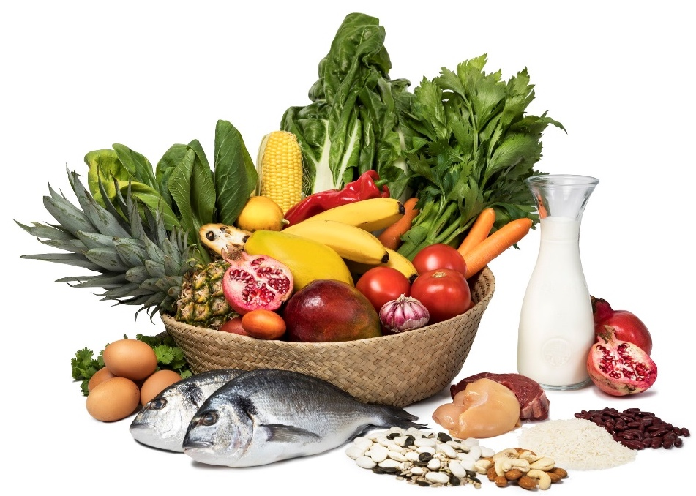
CASE STUDY 1
Bangladesh policy chatbot
Delivering improved nutrition and other food systems goals in an equitable, inclusive way requires having supportive policies, and getting those policies is far more likely if advocates can understand what the policies say in the first place.
But this is difficult
Food system policies span many sectors and can be hard to track down
They’re often long, technical documents full of jargon

Slide 9
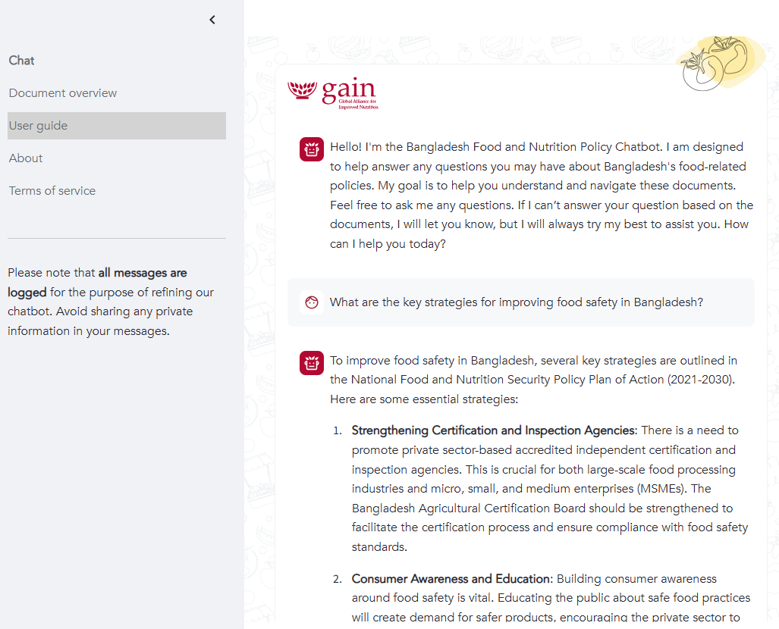
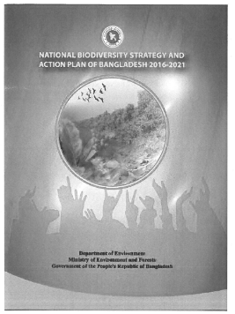





Could a chatbot help do it?
THE APPROACH
AI-powered large language models can process text much faster than humans; chatbots provide a user-friendly interface for communicating.
So, we built a custom chatbot for understanding food policies (applied to Bangladesh as the pilot test).
ChatGPT based custom chatbot
28 food policies (over 2,000 pages)
Check it out: https://policybot.gainhealth.org/

Slide 10
Positive feedback – but also limitations
THE RESULTS
Strengths
High level of accuracy
Provided clear and understandable responses to natural-language questions
Easy to use
Overall, largely met the main goal of making policies more accessible to food systems actors
Limitations
Comparing across policies and providing responses that considered all policies comprehensively, which limits the potential applications as a research tool
Bottom line: Overall the chatbot offers a user-friendly, accurate, and informative tool that lets users talk directly with Bangladeshi food policies—and learn more about them in the process.

Slide 11
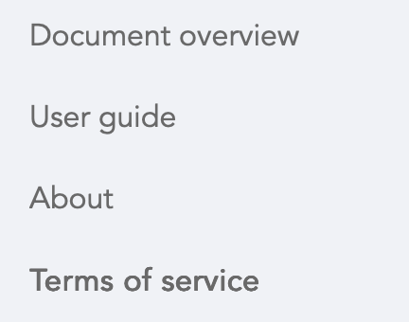
Ensuring ethical use of the chatbot
RESPONSIBLE AI
Curated policy documents the model had access to
Description of each background policy document
Provided user guide with example prompts
Terms of service
GAIN curates and discloses every source document behind the chatbot, so every answer can always be traced back to verifiable, vetted policy text.

Slide 12
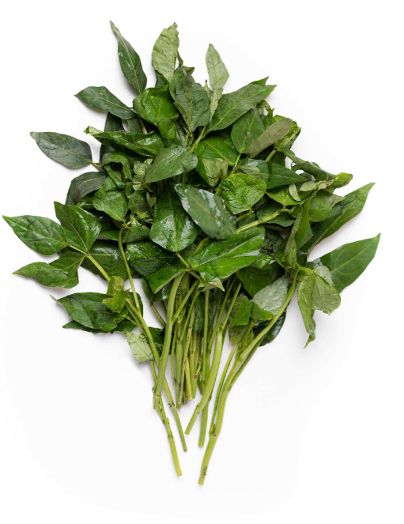

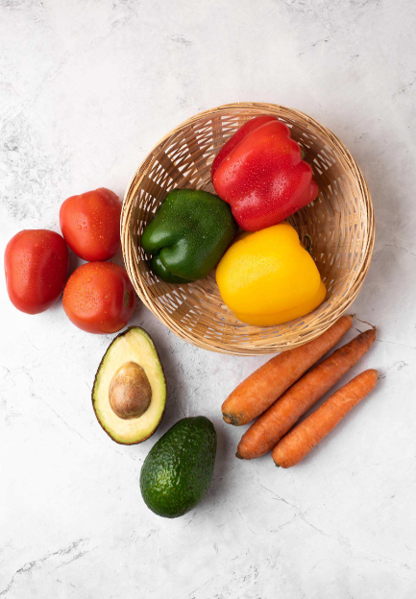

CASE STUDY 2
Food Fiti: Vegetables for All in Kenya
Getting affordable vegetables to low-income urban consumers requires knowing where those communities are and reaching the informal vendors (‘mama mbogas’) who serve them every day.
But this is difficult
National statistics stop at ward level: too difficult to pinpoint the low-income neighborhoods most in need
Informal, last-mile vendors are largely unmapped, making programmes hard to plan and monitor

Slide 13
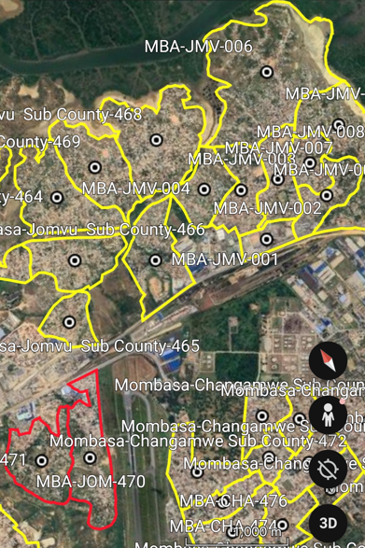
Mapping communities with AI
THE APPROACH
Partnered with Atlas AI, combining machine learning, predictive analytics, and satellite imagery to fill gap in national statistics
Guided by the map, field teams geotagged ‘mama mbogas’ and other last-mile vendors
Verified areas became FoodFiti Zones loaded onto Google Earth for programme delivery
AI narrowed the search from whole counties to specific neighborhoods, making manual vendor mapping feasible at scale

Slide 14
1,000 zones, 3 million people reached
THE RESULTS
Scale achieved
1,000 Food FitiZones mapped, field verification confirmed and activated 604 zones across five counties
Each zone serves around 5,000 people through 15 or more mapped vegetable vendors
14,000 mama mbogas geotagged, a vendor database covering every active zone
What it enables
Zone maps and the vendor database guide daily delivery, targeted implementation, vendor onboarding, and programme monitoring as the programme grows.
Bottom line: AI-powered mapping turned a data gap into a delivery platform: Food Fiti Zones now define where the programme works and who it works with.

Slide 15
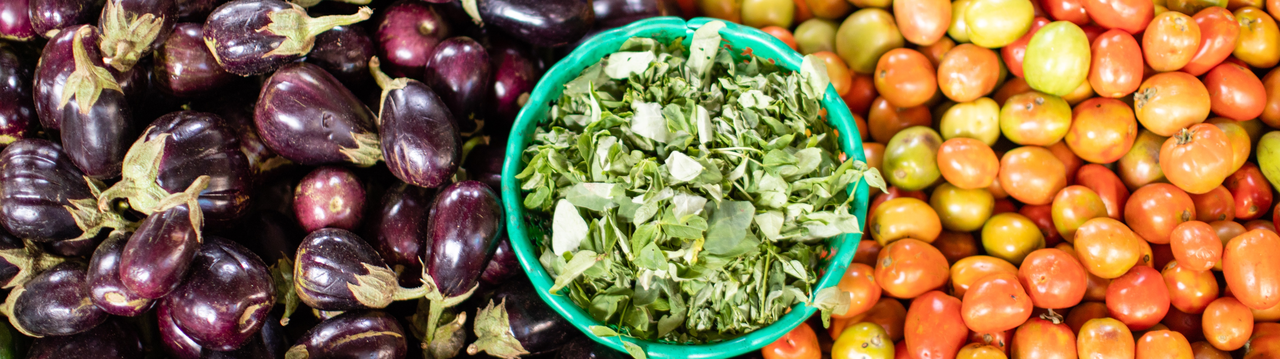

Thank you
Rue Varembé 7, 1202 Geneva, Switzerland
Mailing address: PO box 55, 1211 Genève 20
www.gainhealth.org
info@gainhealth.org
@GAINAlliance

